Slide 1
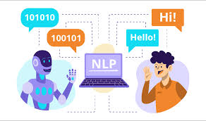
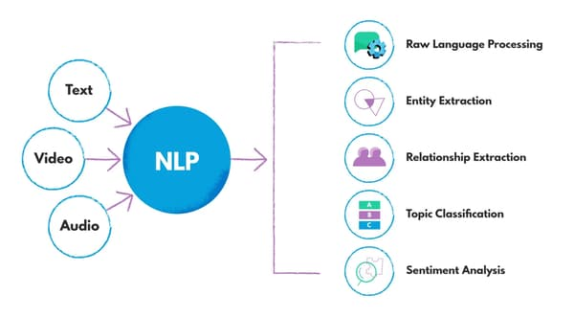

UNIT_1_Introduction to NLP
Presented by:
Dr. G. S. Bhavekar
B.E, M.E, Ph.D. (VIT )
Associate Professor
AI&DS Engineering
CSMSS CSCOE

Slide 2
UNIT 1
Definition and scope of NLP,
Applications and real-world examples of NLP,
Linguistic Fundamentals: Regular Expressions,
Words,
Corpora,
Text Normalization: Tokenization and
segmentation,
Stop word removal,
Stemming and lemmatization,
Handling capitalization and punctuation,
Minimum Edit distance.

Slide 3
1.1Definition and scope of NLP
Natural language processing (NLP) is a subset of artificial intelligence, computer science, and linguistics focused on making human communication, such as speech and text, comprehensible to computers.
NLP is used in a wide variety of everyday products and services. Some of the most common ways NLP is used are through voice-activated digital assistants on smartphones, email-scanning programs used to identify spam, and translation apps that decipher foreign languages.

Slide 4
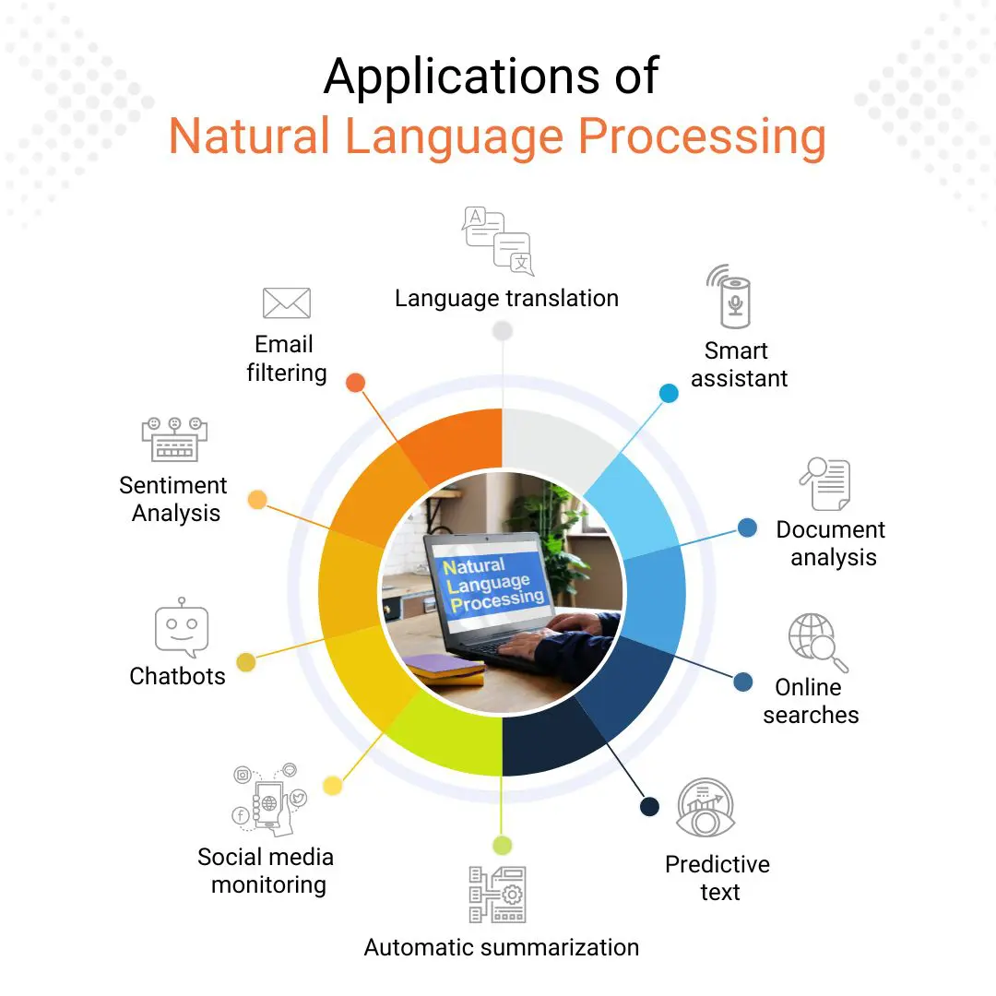

Slide 5
Scope of NLP
Natural language techniques
NLP encompasses a wide range of techniques to analyze human language. Some of the most common techniques you will likely encounter in the field include:
Sentiment analysis: An NLP technique that analyzes text to identify its sentiments, such as “positive,” “negative,” or “neutral.” Sentiment analysis is commonly used by businesses to better understand customer feedback.
Summarization: An NLP technique that summarizes a longer text, in order to make it more manageable for time-sensitive readers. Some common texts that are summarized include reports and articles.
Keyword extraction: An NLP technique that analyzes a text to identify the most important keywords or phrases. Keyword extraction is commonly used for search engine optimization (SEO), social media monitoring, and business intelligence purposes.
Tokenization: The process of breaking characters, words, or subwords down into “tokens” that can be analyzed by a program. Tokenization undergirds common NLP tasks like word modeling, vocabulary building, and frequent word occurrence.

Slide 6
Linguistic Fundamentals, Regular Expressions RegEx
Regular expressions or RegEx is defined as a sequence of characters that are mainly used to find or replace patterns present in the text. In simple words, we can say that a regular expression is a set of characters or a pattern that is used to find substrings in a given string.
A regular expression (RE) is a language for specifying text search strings. It helps us to match or extract other strings or sets of strings, with the help of a specialized syntax present in a pattern.
For Example, extracting all hashtags from a tweet, getting email iD or phone numbers, etc from large unstructured text content.

Slide 7
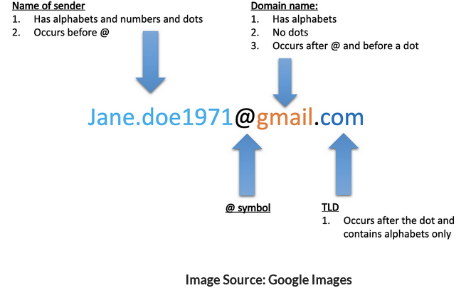
Sometimes, we want to identify the different components of an email address.

Slide 8
Simply put, a regular expression is defined as an ”instruction” that is given to a function on what and how to match, search or replace a set of strings.
Regular Expressions are used in various tasks such as,
Data pre-processing,
Rule-based information Mining systems,
Pattern Matching,
Text feature Engineering,
Web scraping,
Data Extraction, etc.

Slide 9
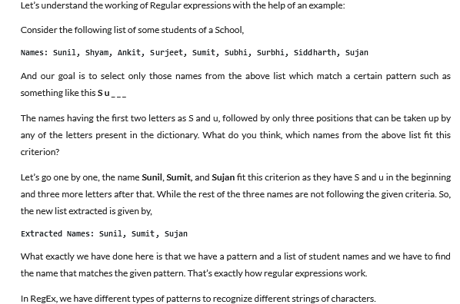
How do Regular Expressions Work?

Slide 10
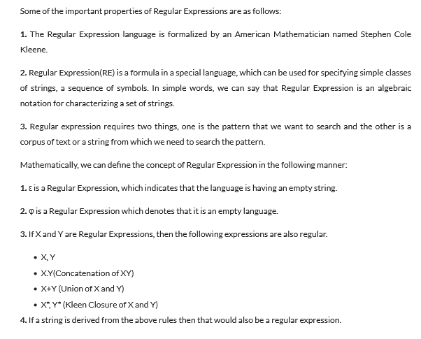
Properties of Regular Expressions

Slide 11
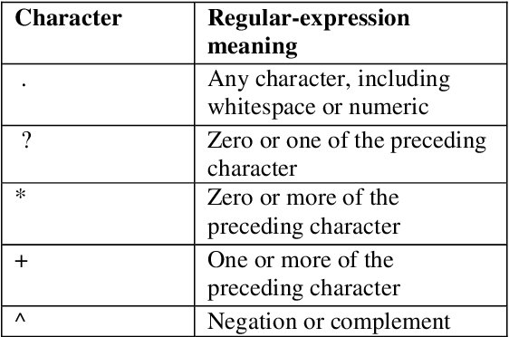
12/8/2023 , 56,10,63,70,41,46,37,22,34,47,18,52,60

Slide 12
Corpus
What is a corpus?
A corpus is a collection of authentic text or audio organized into datasets.
Authentic here means text written or audio spoken by a native of the language or dialect.
A corpus can be made up of everything from newspapers, novels, recipes, radio broadcasts to television shows, movies, and tweets.
In natural language processing, a corpus contains text and speech data that can be used to train AI and machine learning systems.
If a user has a specific problem or objective they want to address, they’ll need a collection of data that supports, or at least is a representation of, what they’re looking to achieve with machine learning and NLP.

Slide 13
What are the features of a good corpus?
Large corpus size: Generally, the larger the size of a corpus, the better for NLP model to train. Large quantities of specialized datasets are vital to training algorithms designed to perform sentiment analysis or related tasks.
High-quality data: High quality is crucial when it comes to the data within a corpus. Due to the large volume of data required for a corpus, even minuscule errors in the training data can lead to large-scale errors in the machine learning system’s output.
Clean data: Data cleansing is also vital for creating and maintaining a high-quality corpus. Data cleansing allows identifying and eliminating any errors or duplicate data to create a more reliable corpus for NLP.
Balance: A high-quality corpus is a balanced corpus. While it can be tempting to fill a corpus with everything and anything available, if one doesn’t streamline and structure the data collection process, it could unbalance the relevance of the dataset.

Slide 14
What are the challenges regarding creating a corpus?
Deciding the type of data needed to solve the problem statement
Availability of data
Quality of the data
Adequacy of the data in terms of the amount
Example
Corpus creation for Marathi language or native languages etc
Corpus creation of foreign language

Slide 15
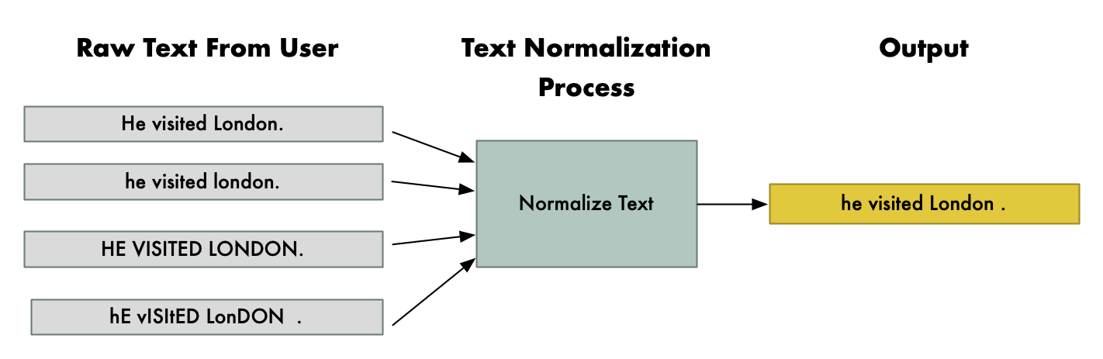
Text Normalization
Text normalization is a pre-processing step aimed at improving the quality of the text and making it suitable for machines to process. Four main steps in text normalization are case normalization, tokenization and stop word removal, Parts-of-Speech (POS) tagging, and stemming.
Types: Text into sentences tokenization
Sentences into words tokenization
Sentences using regular expressions tokenization

Slide 16
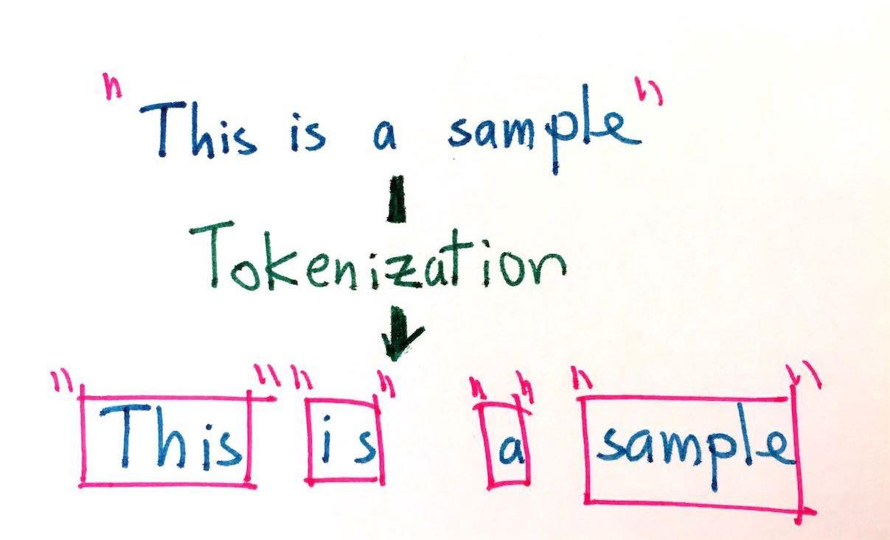
Tokenization
In this process, we break down a piece of input text into smaller units called tokens. This helps in treating each token(word, character, etc.) as an individual component for further processing and analysis. The text is commonly converted into individual tokens by splitting them from whitespaces. Sentence: "I am a big fan of metal music!" Whitespace tokenizer: "I","am","a","big","fan","of","metal","music!" Regular expressions can also be used for tokenization.

Slide 17
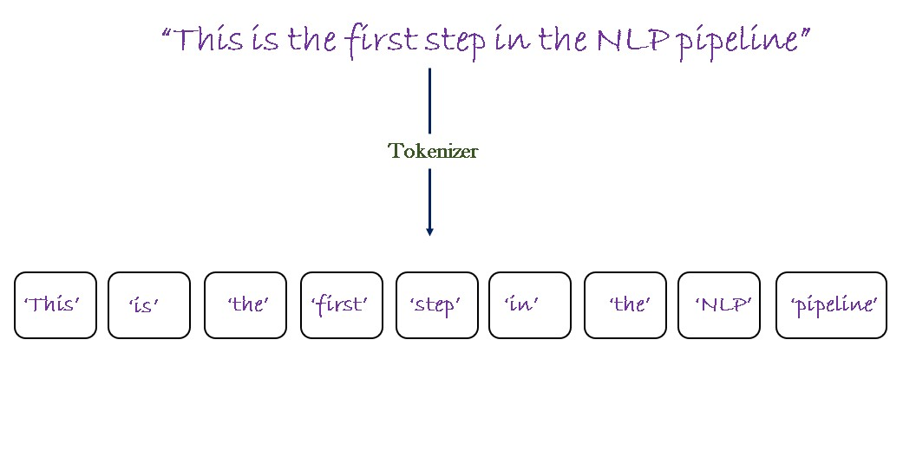
Tokenization is the process of replacing sensitive data with unique identification symbols that retain all the essential information about the data without compromising its security.

Slide 18
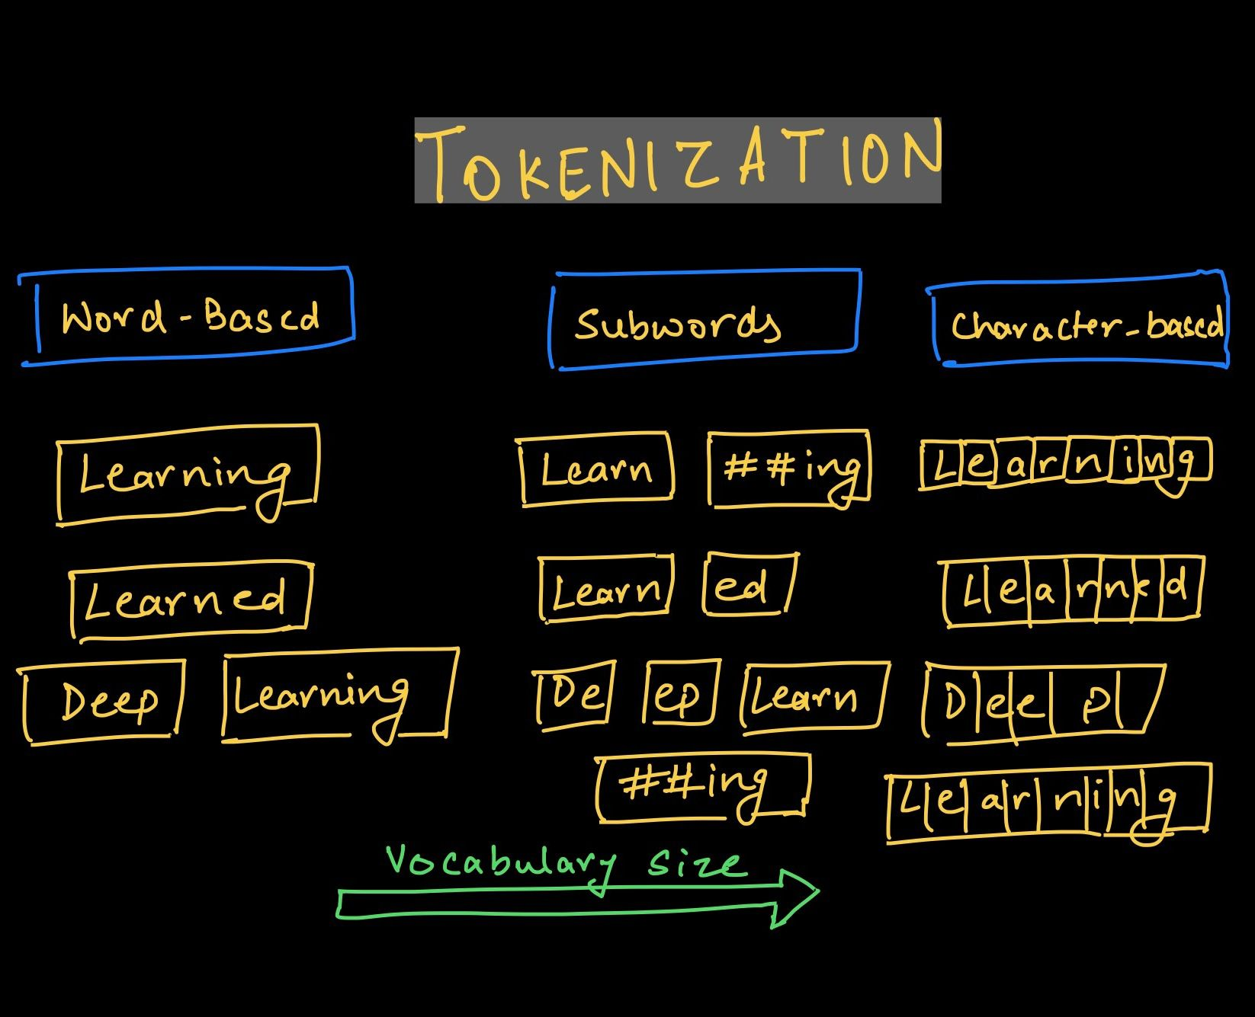

Slide 19
Why do we need a Tokenizer?
The need for a tokenizer came from the question "How can we make machines read?“
A common way of processing textual data is to define a set of rules in a dictionary and then look up that fixed dictionary of rules. But this method can only go so far, and we want machines to learn these rules from the text that it reads.
Now, machines don't know any language, nor do they understand sound or phonetics. They need to be taught from scratch and in such a way that they can read any language that's out there.

Slide 20
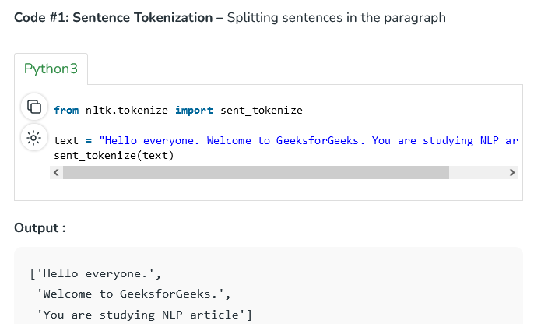
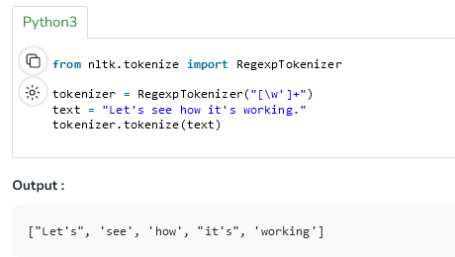

Slide 21
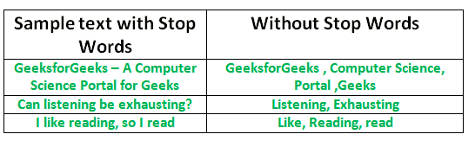
Stop word removal
Stop word removal is one of the most commonly used preprocessing steps across different NLP applications. The idea is simply removing the words that occur commonly across all the documents in the corpus. Typically, articles and pronouns are generally classified as stop words.

Slide 22
Sentence Segmentation
The process of deciding from where the sentences actually start or end in NLP or we can simply say that here we are dividing a paragraph based on sentences. This process is known as Sentence Segmentation. In Python, we implement this part of NLP using the spacy library.
Spacy is used for Natural Language Processing in Python.

Slide 23
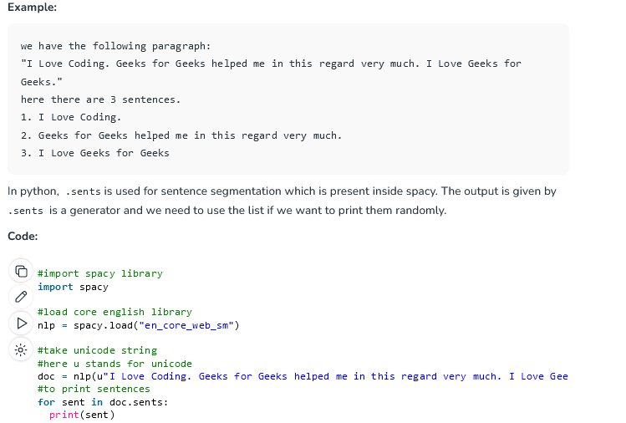

Slide 24
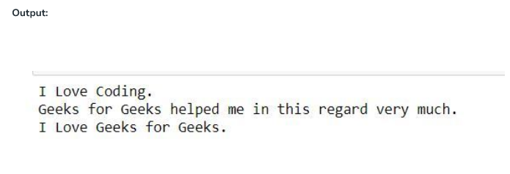
Output

Slide 25
Stemming
What is Stemming?
Stemming is a natural language processing technique that is used to reduce words to their base form, also known as the root form. The process of stemming is used to normalize text and make it easier to process.
Stemming is an important part of the pipelining process in Natural language processing. The input to the stemmer is tokenized words
Stemming is the process of reducing a word to its word stem that affixes to suffixes and prefixes or to the roots of words known as a lemma. Stemming is important in natural language understanding (NLU) and natural language processing (NLP).

Slide 26
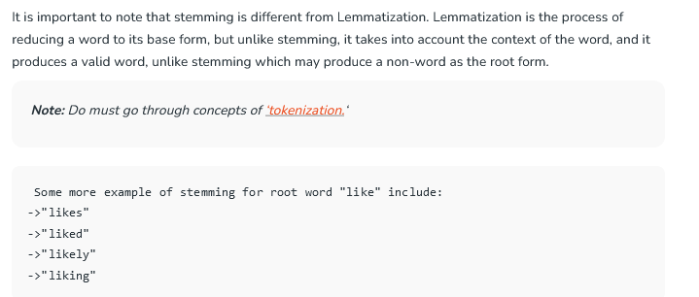

Slide 27
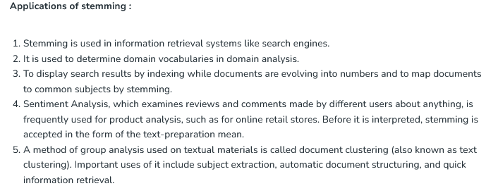

Slide 28
Lemmatization
Lemmatization usually refers to doing things properly with the use of a vocabulary and morphological analysis of words, normally aiming to remove inflectional endings only and to return the base or dictionary form of a word, which is known as the lemma .
The lemma of 'was' is 'be' and the lemma of 'mice' is 'mouse’.
Further, the lemma of 'meeting' might be 'meet' or 'meeting’
depending on its use in a sentence.

Slide 29
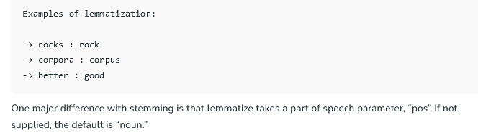

Slide 30
Lemmatization is the process of grouping together the different inflected forms of a word so they can be analyzed as a single item. Lemmatization is similar to stemming but it brings context to the words. So it links words with similar meanings to one word.
Text preprocessing includes both Stemming as well as Lemmatization. Many times people find these two terms confusing. Some treat these two as the same. Actually, lemmatization is preferred over Stemming because lemmatization does morphological analysis of the words.
Applications of lemmatization are:
Used in comprehensive retrieval systems like search engines.
Used in compact indexing

Slide 31
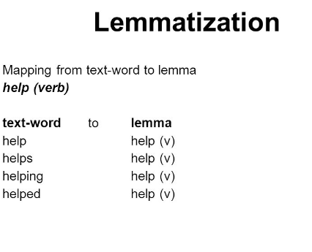
Lemmatization

Slide 32
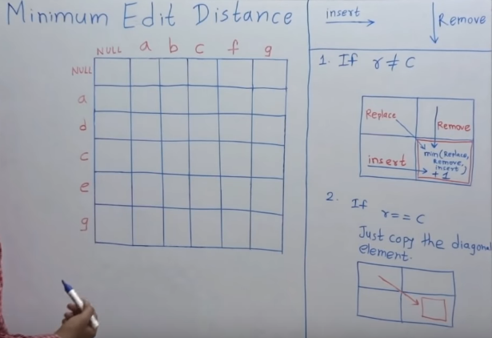
Min.Edit Distance Levenshtein distance

